Slide 1

Financial Aid
The College Student Budgeting App
M. Dubuc, I. King, A. Massey, J. McGarty, & D. Stowell
COMSC 230
April 29, 2019

Slide 2
Part I
Research

Slide 3



Quick Statistics
58% of students claim they are not saving money each month(LendEDU)
43% of students claim they do not track monthly spending (LendEDU)
7 out of 10 students stress over personal finances (Ohio State University)
Notes:
Misha Dubuc

Slide 4



Competitors
Digit (general)
Personal Capital (investments)
Goodbudget (couples)
However, college students face a unique financial struggle—which none of these apps directly address.
This is where Financial Aid steps in.
Notes:
Misha Dubuc

Slide 5
Part II
View

Slide 6
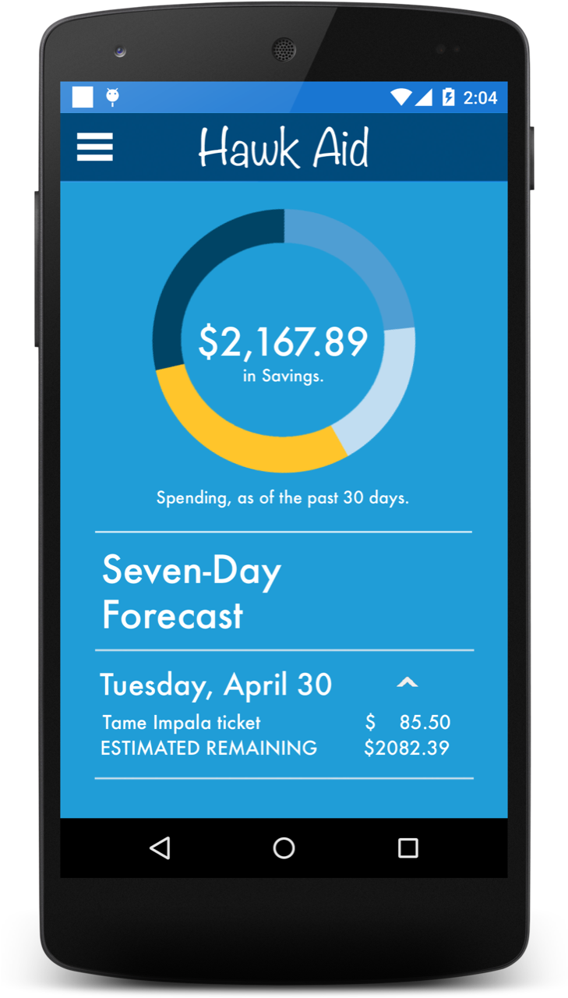
Homepage
Data Hub
Shows amount in account (linked)
Donut chart for areas of spending (food, supplies, housing, etc.)
Percentage of spending in one area, when pressed
Seven-Day Forecast
Scrollable list of events for upcoming week
Each day is expandable by press
Estimates amount remaining in account
Notes:
Aaron Massey

Slide 7
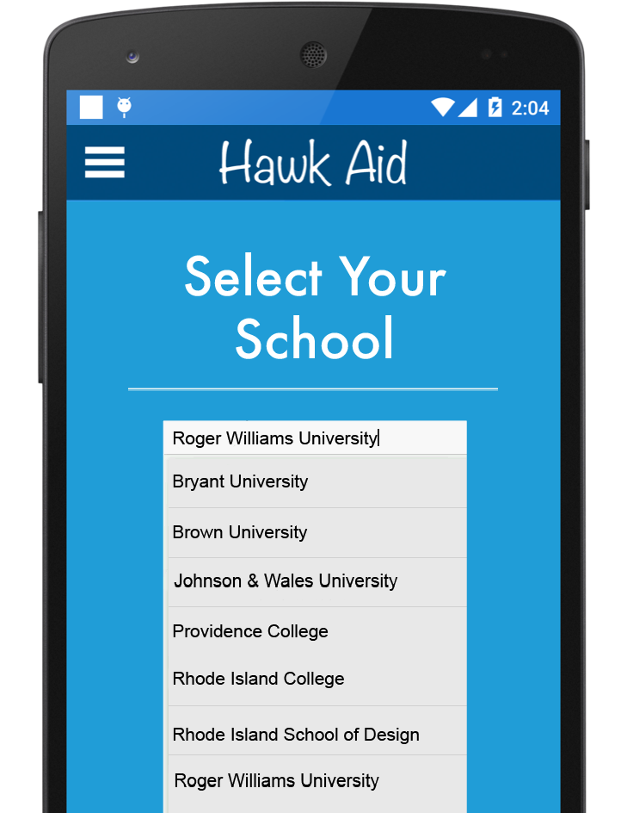
Select Your School
Personalize your experience, based on your school
Drop-down menu of universities
Also searchable
Recommended restaurants, venues, etc. depend on school selected
UI changes with school mascot, colors
All information stored in a SQL table
Notes:
Aaron Massey

Slide 8
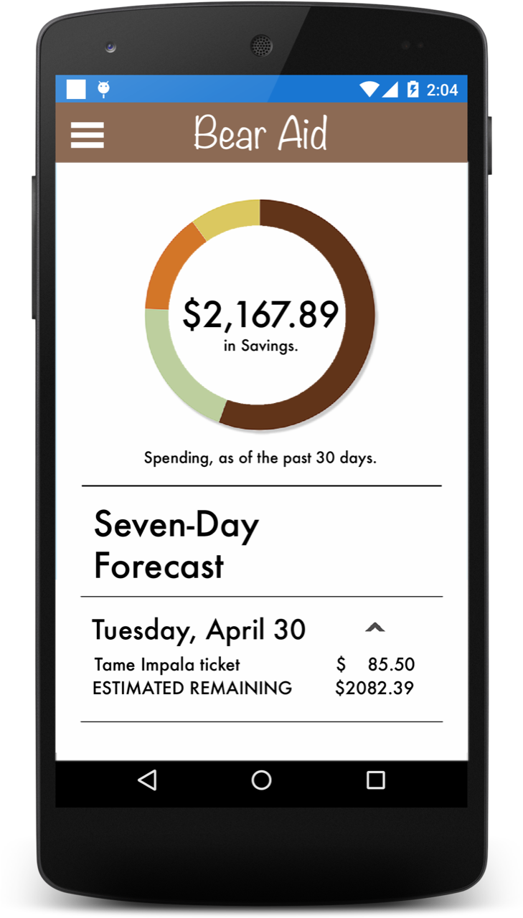
Changing to Brown University
Notes:
Aaron Massey

Slide 9
Part III
Control

Slide 10
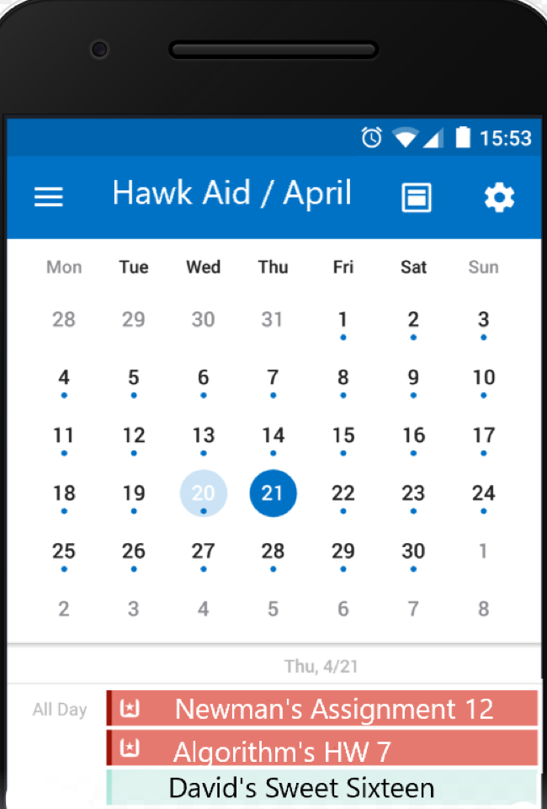
Calendar
Stores typed notes in daily planner
Important events will be marked in red, while costly events will be marked in green
Adding financial notes will update Seven-Day Forecast
All input transferred to SQL table
Notes:
Jordan McGarty

Slide 11
Part IV
Model

Slide 12
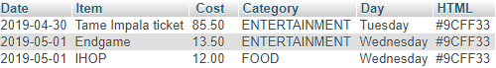

Calendar Database
Stores items (or events) based on user’s typed input
Stores dates to fit calendar and Seven-Day Forecast
Hard-defined categories (food, clothing, etc.) to gauge donut chart
Two HTML codes: red (important) and green (costly)
Notes:
Jordan McGarty

Slide 13
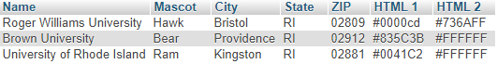
‘Select Your School’ Database
School mascot for personalized header (i.e., Hawk Aid)
Address for local, affordable recommendations
HTML codes for UI to reflect school colors
Updates for any newly accredited schools
Notes:
David Stowell

Slide 14
Planned Features
Adding Scheduled Reminders
More customizable options
Multiple color schemes per school
Profile pictures
Improved quality of life features
Favorite certain spending habits (i.e., favorite movie theater tickets)
Tips on how to balance areas of spending
Notes:
an KingIan

Slide 15

Planned Features (cont.)
Activity recommendation service
Ex: Eating out
Our app references local restaurants by using google maps
Lists establishments based on google reviews
Notes:
Ian King

